Slide 1
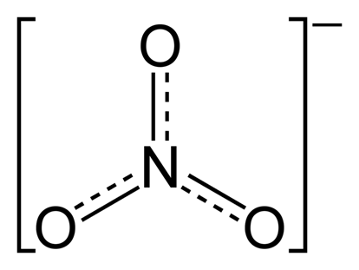
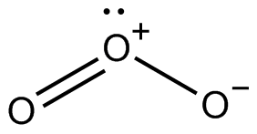
Comprehensive Isotopic Composition of Atmospheric Nitrate during CalNex
Inferring Sinks and Sources of NO_{X} from Nitrate Stable Isotope Ratios
William C. Vicars, Samuel Morin, and Joël Savarino
Laboratoire de Glaciologie et Géophysique de l’Environnement Université Joseph Fourier, CNRS, Grenoble, France

Slide 2
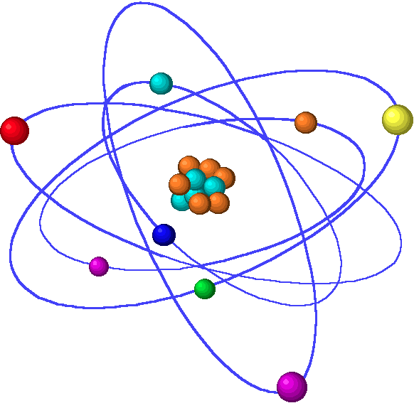
Stable Isotope Basics
Oxygen: ¹⁶O, ¹⁷O, ¹⁸O
Nitrogen: ¹⁴N, ¹⁵N
Atmospheric nitrate (HNO₃ / NO₃⁻) isotope ratios (¹⁷O/¹⁶O, ¹⁸O/¹⁶O, and ¹⁵N/¹⁴N) serve as interpretive tools to quantify NO_{X} sources and removal mechanisms
Delta (δ and Δ) values in units of “per mil” (‰)
δ¹⁷O_{sample} = (¹⁷O/¹⁶O)_{sample} / (¹⁷O/¹⁶O)_{standard} - 1

Slide 3
Stable Isotope Basics
Oxygen: ¹⁶O, ¹⁷O, ¹⁸O
Nitrogen: ¹⁴N, ¹⁵N
Atmospheric nitrate (HNO₃ / NO₃⁻) isotope ratios (¹⁷O/¹⁶O, ¹⁸O/¹⁶O, and ¹⁵N/¹⁴N) serve as interpretive tools to quantify NO_{X} sources and removal mechanisms
Delta (δ and Δ) values in units of “per mil” (‰)
δ¹⁸O_{sample} = (¹⁸O/¹⁶O)_{sample} / (¹⁸O/¹⁶O)_{standard} - 1

Slide 4
Stable Isotope Basics
Oxygen: ¹⁶O, ¹⁷O, ¹⁸O
Nitrogen: ¹⁴N, ¹⁵N
Atmospheric nitrate (HNO₃ / NO₃⁻) isotope ratios (¹⁷O/¹⁶O, ¹⁸O/¹⁶O, and ¹⁵N/¹⁴N) serve as interpretive tools to quantify NO_{X} sources and removal mechanisms
Delta (δ and Δ) values in units of “per mil” (‰)
δ¹⁵N_{sample} = (¹⁵N/¹⁴N)_{sample} / (¹⁵N/¹⁴N)_{standard} - 1

Slide 5
Stable Isotope Basics
Oxygen: ¹⁶O, ¹⁷O, ¹⁸O
Nitrogen: ¹⁴N, ¹⁵N
Atmospheric nitrate (HNO₃ / NO₃⁻) isotope ratios (¹⁷O/¹⁶O, ¹⁸O/¹⁶O, and ¹⁵N/¹⁴N) serve as interpretive tools to quantify NO_{X} sources and removal mechanisms
Delta (δ and Δ) values in units of “per mil” (‰)
Δ¹⁷O = δ¹⁷O - 0.52*δ¹⁸O

Slide 6
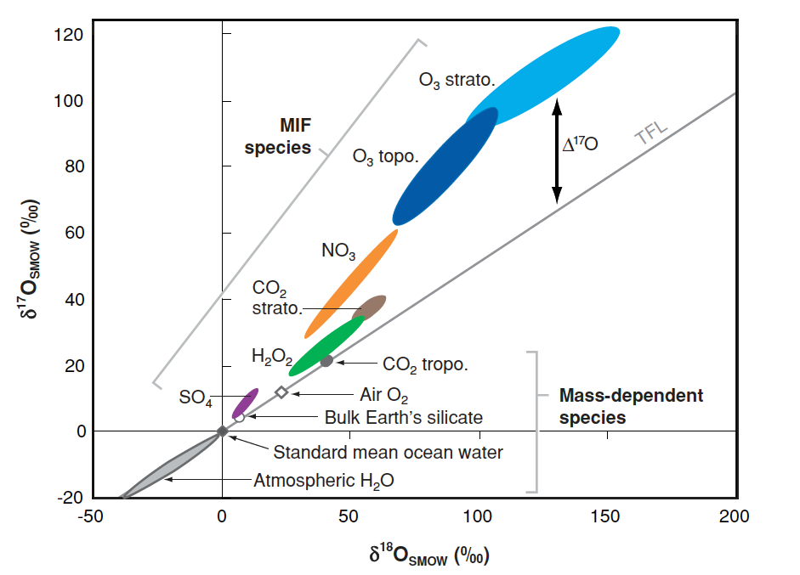
The Oxygen Isotope “Anomaly” (Δ¹⁷O) of Ozone
O₃ tropo.
Δ¹⁷O = 20-35 ‰
δ¹⁷O = 0.52*δ¹⁸O
Δ¹⁷O = 0
Thiemens, 2006, Annu. Rev. Earth Planet Sci.

Slide 7
Isotope Transfer During NO_{X} Oxidation
XO
RH
Nighttime
NO₂
N₂O₅
NO₃
X
O₃
Higher Δ¹⁷O Transfer
heterogeneous
O₃
XONO₂
NO₂
XO
HNO₃
NO
RO₂
OH
Daytime
Lower Δ¹⁷O Transfer
time scale: minutes
hours to days

Slide 8
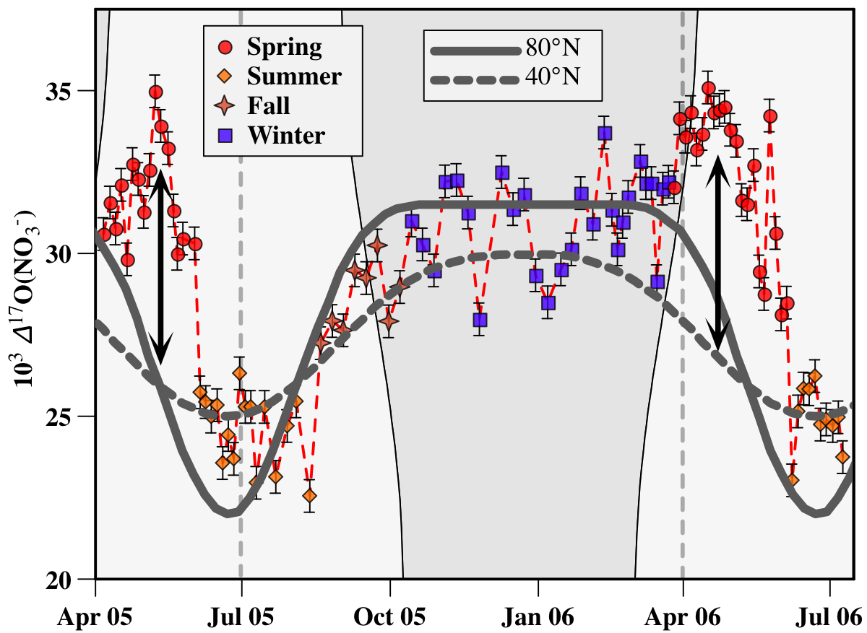
Δ¹⁷O of Atmospheric Nitrate as a Useful Tool in Atmospheric Chemistry
Seasonal minimum values concurrent with low O₃ (polar day, daytime chemistry)
Δ¹⁷O (NO₃⁻) values higher in winter due to increased interaction with O₃ (polar night)
Seasonal maxima reflect interaction of NO_{x} with BrO and are not predicted by O₃ chemistry alone
Morin et al., 2008, Science

Slide 9
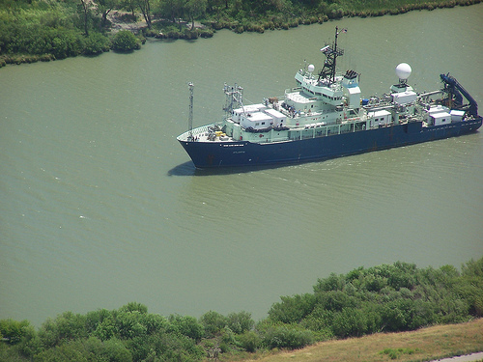
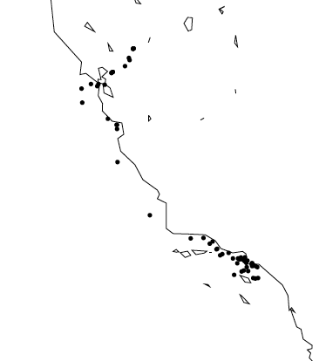
CalNex 2010
High Volume PM sampling
63 sets of samples
coarse and fine fractions (1 μm cut-point)
26 sets from S. Cal. are 12 hour (day and night) collections (May 15 - 28)
daytime vs. nighttime chemistry
34 subsequent sets have lower sampling durations (May 29 - June 7)
San Francisco
LA
San Diego

Slide 10
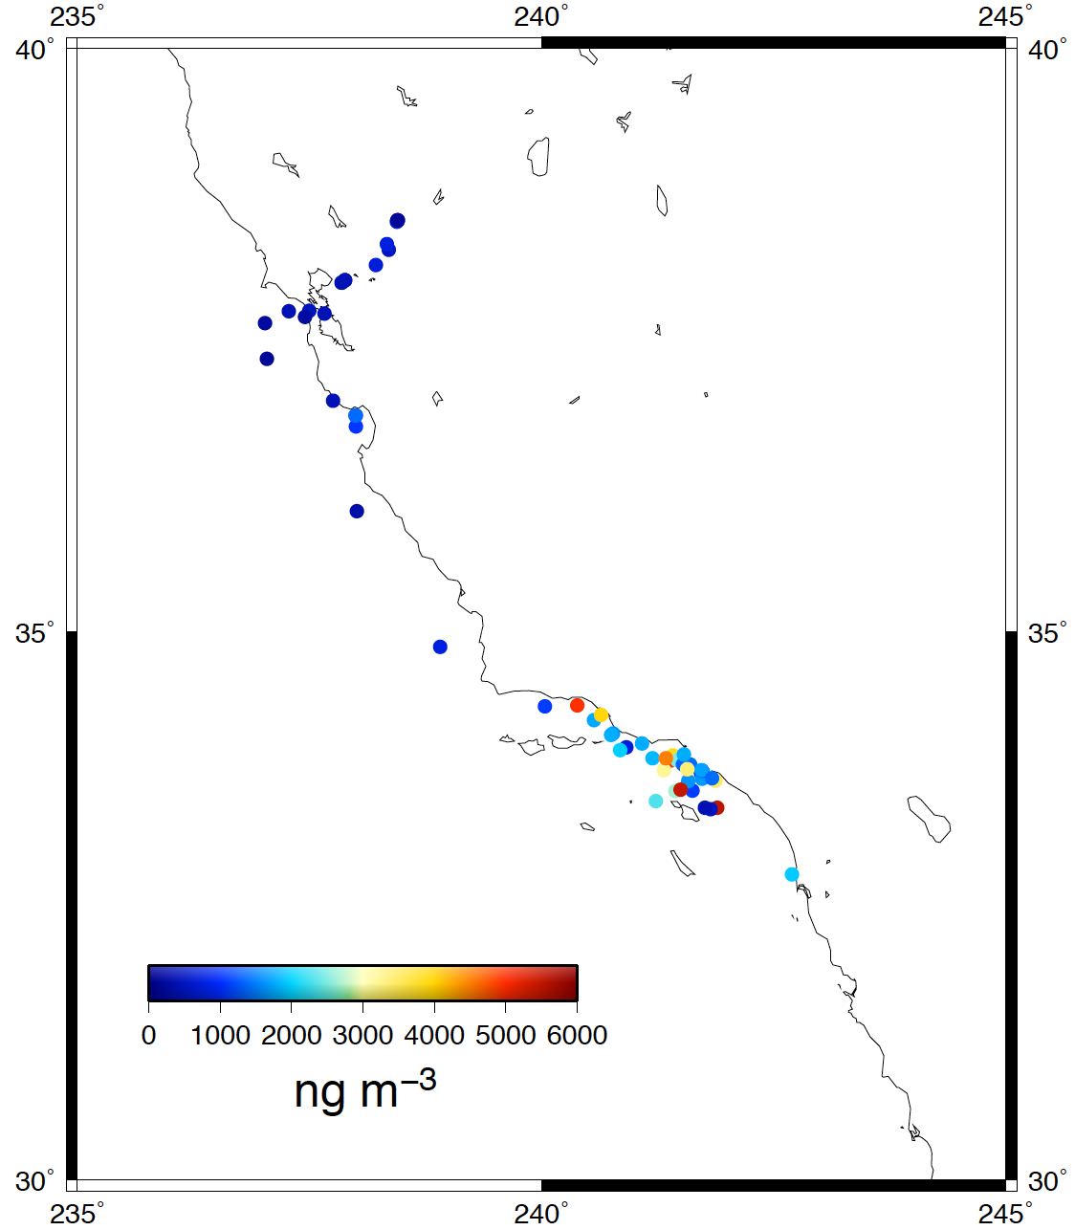
Atmospheric Nitrate Concentration During CalNex
 | Ave. | Max. | Min. | Std. Dev.
LA | 2348 | 5475 | 409 | 1382
SF | 419 | 857 | 178 | 191
San Francisco
LA
San
Diego

Slide 11
Air Mass Origins during CalNex

Slide 12
O₃ and NO_{X} during CalNex
O₃
NO
NO₂

Slide 13
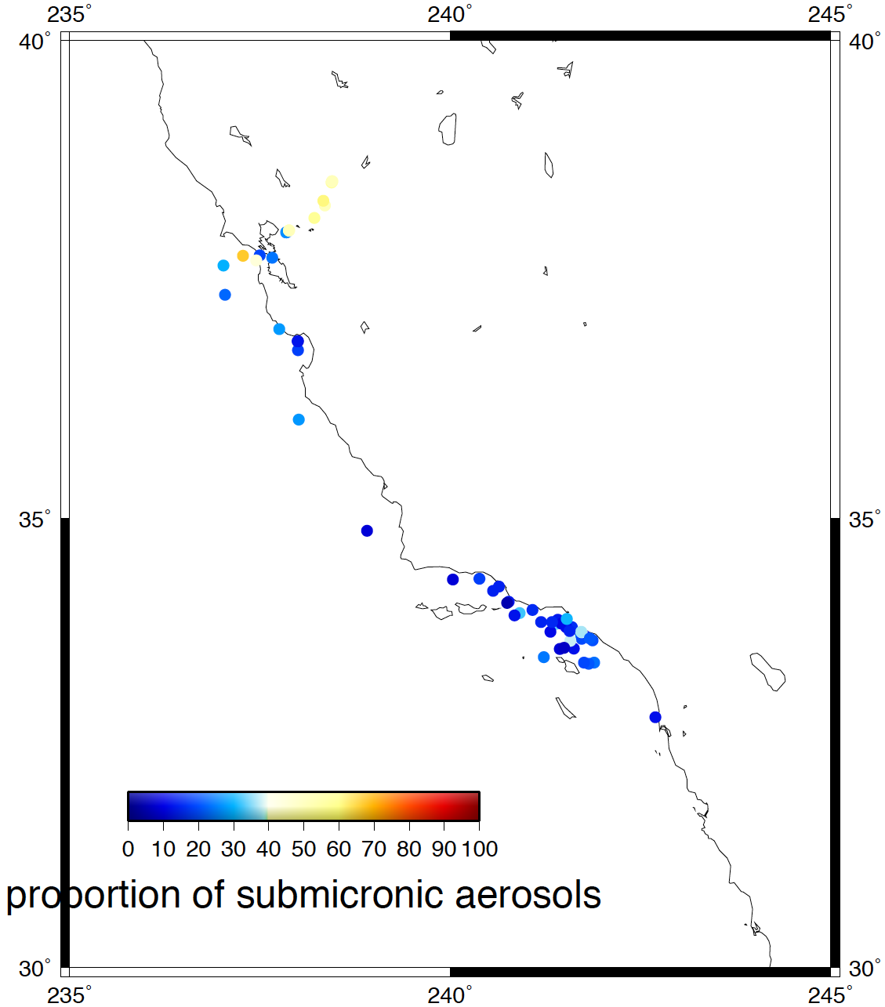
Particle Size Distribution of Nitrate
 | Ave. | Max. | Min. | Std. Dev.
LA-C | 1861 | 5101 | 330 | 1153
LA-F | 487 | 2808 | 79 | 512
SF-C | 224 | 392 | 87 | 97
SF-F | 195 | 481 | 42 | 138
San Francisco
LA
San
Diego

Slide 14
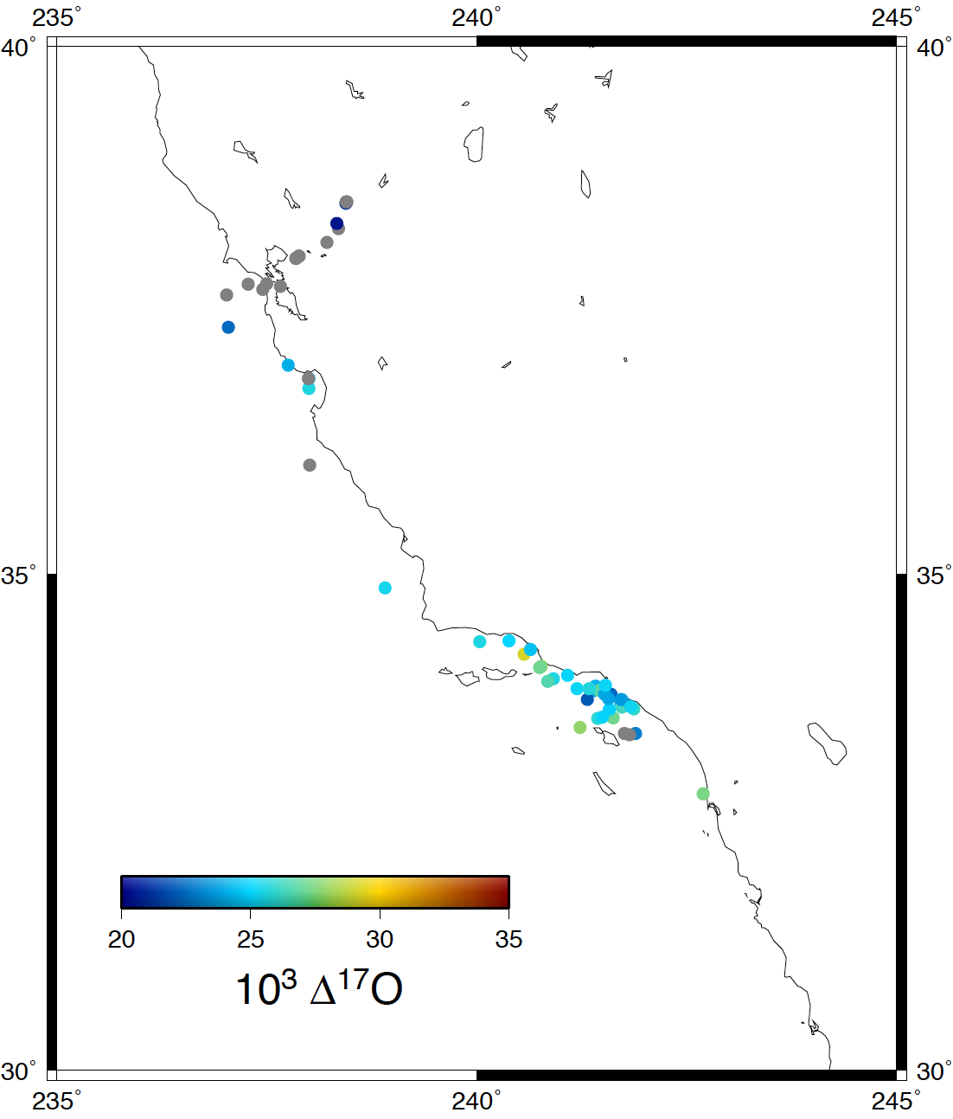
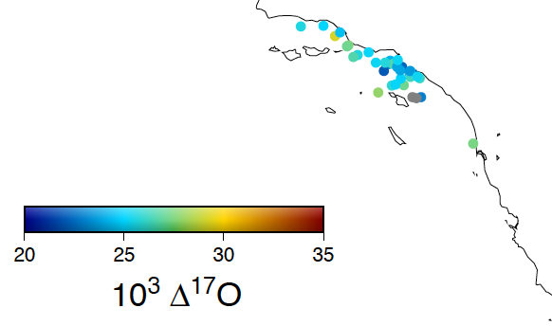
Oxygen Isotope Anomaly (Δ¹⁷O) of Atmospheric Nitrate
 | Ave. | Max. | Min. | Std. Dev.
LA | 25.3 | 29.2 | 21.9 | 1.6
SF | 21.8 | 23.0 | 20.5 | 1.2
San Francisco
LA
San
Diego

Slide 15
Δ¹⁷O (NO₃⁻) - Diurnal Variations

Slide 16
Δ¹⁷O (NO₃⁻) - Diurnal Variations

Slide 17
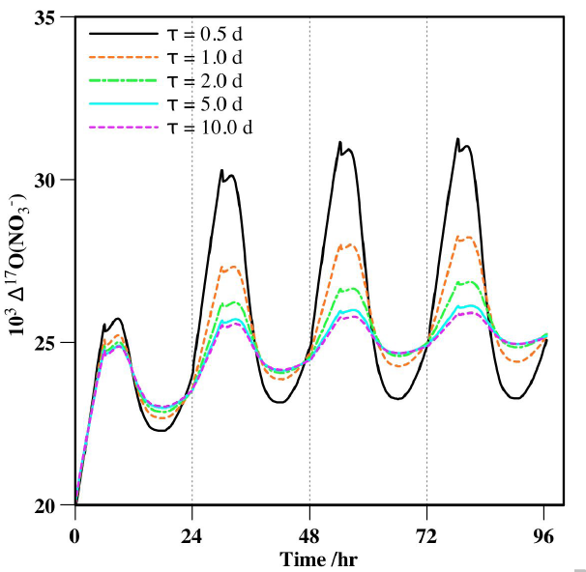
Lifetime Effect of Atmospheric Nitrate
Typical atmospheric residence time (τ) of 1 day
Function of NO₃⁻ particle size distribution (i.e., deposition velocity)
CalNex May 15-28 samples were collected from approx. 9am - 7pm (“day”) and 7pm - 9am (“night”)
Mixing of “daytime” and “nighttime” Δ¹⁷O signal
Morin et al., 2010, EGU Annual Meeting

Slide 18
Δ¹⁷O (NO₃⁻) - Diurnal Variations

Slide 19
Δ¹⁷O (NO₃⁻) - Diurnal Variations

Slide 20
P_{n} and P_{d}
A simplified Δ¹⁷O (NO₃⁻) interpretive framework
Based on isotope mass balance, Δ¹⁷O (NO₃⁻) is expected to be proportional to the the ratio of nighttime to daytime nitrate production
P_{d}
NO₂ + OH → HNO₃
P_{d} α k [NO₂] [OH]
P_{n}
NO₂ + O₃ → NO₃ + O₂
P_{n} α k [NO₂] [O₃]
j(O₃)
Δ¹⁷O (NO₃⁻) α P_{n}/(P_{n} + P_{d})

Slide 21
P_{n} / (P_{n} + P_{d}) and Δ¹⁷O (NO₃⁻) Co-evolve

Slide 22
P_{n} / (P_{n} + P_{d}) and Δ¹⁷O (NO₃⁻) Co-evolve

Slide 23
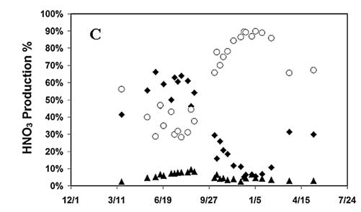
Towards a Better Understanding of the CalNex Δ¹⁷O (NO₃⁻) Data
P₁
NO₂ + OH + M → HNO₃ + M
NO₂ + O₃ → NO₃ + O₂ and NO₃ + RH (DMS) → HNO₃ + products
NO₂ + NO₃ → N₂O₅ and N₂O₅ + H₂O_{(surface)} → 2HNO_{3(aq)}
P₂
P₃
Air Mass Chemical Histories
3 days preceding sample collection along air-mass trajectory
NO₃⁻ concentration and residence time (split into size fractions)
NO, NO₂, NO₃, N₂O₅, O₃, HO₂, OH, H₂O₂
T and P
Relative Humidity
Agreement between modeled and measured Δ¹⁷O
Michalski et al., 2003, Geophys. Res. Lett.

Slide 24
δ¹⁵N and NO_{X} Source Apportionment
δ¹⁵N_{sample} = (¹⁵N/¹⁴N)_{sample} / (¹⁵N/¹⁴N)_{standard} - 1
δ¹⁵N of atmospheric NO₃ can help elucidate sources of NO_{X} to the atmosphere, but the data is often difficult to interpret
fuel combustion: 6-13 ‰
soil (biological): < -20 ‰
lightning: ≈ 0 ‰
Differences in δ¹⁵N between coarse and fine particles may be useful diagnostic tools

Slide 25
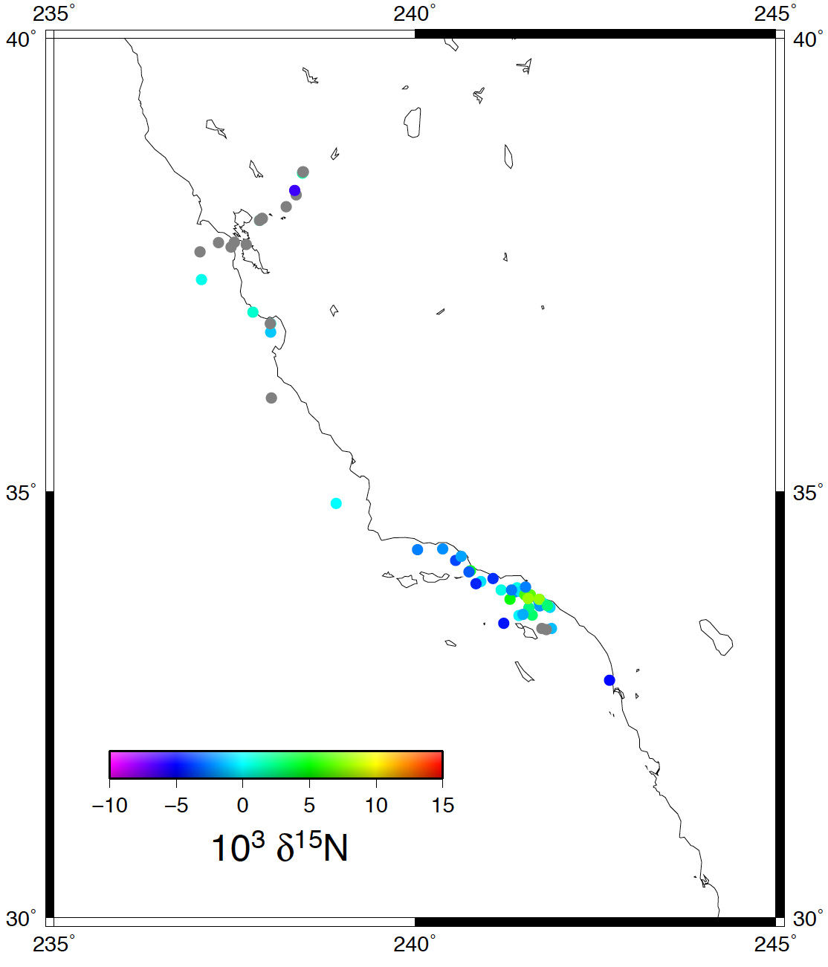
δ¹⁵N of Atmospheric Nitrate
 | Ave. | Max. | Min. | Std. Dev.
LA | 0.2 | 8.0 | -4.6 | 3.5
SF | -0.6 | 1.8 | -6.2 | 3.7
San Francisco
LA
San
Diego

Slide 26
δ¹⁵N (NO₃⁻): Coarse vs. Fine Particles
Average Difference = 2.3 (± 1.5)
Average Difference = 2.7 (± 1.8)
27%
13%

Slide 27
Summary
Variations in Δ¹⁷O (NO₃⁻) during CalNex are a function of the relative importance of “daytime” (P₁) and “nighttime” (P₂ and P₃) reaction mechanisms
Offset in data due to residence time effect of NO₃⁻
A more thorough interpretation of the atmospheric Δ¹⁷O (NO₃⁻) signal will require detailed modeling of the dominant reaction mechanisms
Potential for collaboration, joint publications, etc.

Slide 28
Summary
Small differences in δ¹⁵N between coarse and fine particles suggest a common source of NO_{X} in both size fractions
Different reaction mechanisms (P₁, P₂, P₃) leading to NO₃⁻ formation are sensitive to particle size
Higher δ¹⁵N in S. Cal. May reflect greater contribution of NO_{X} from fuel combustion
The higher Δ¹⁷O (NO₃⁻) for the samples collected near Los Angeles may be due to the greater abundance of coarse particle mass
Greater HNO₃ production via N₂O₅ hydrolysis in coarse particles?

Slide 29
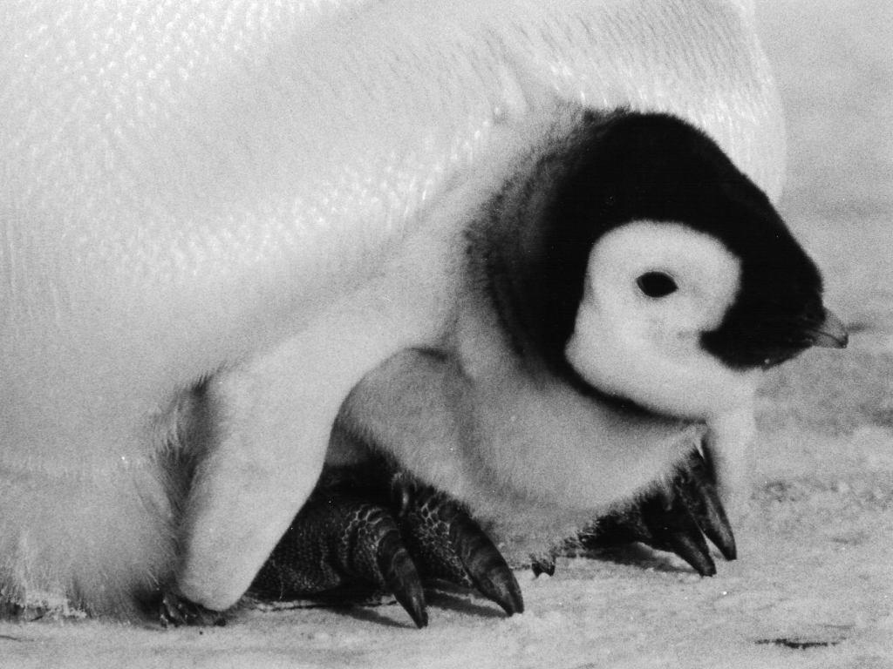
Thank You!

Slide 30
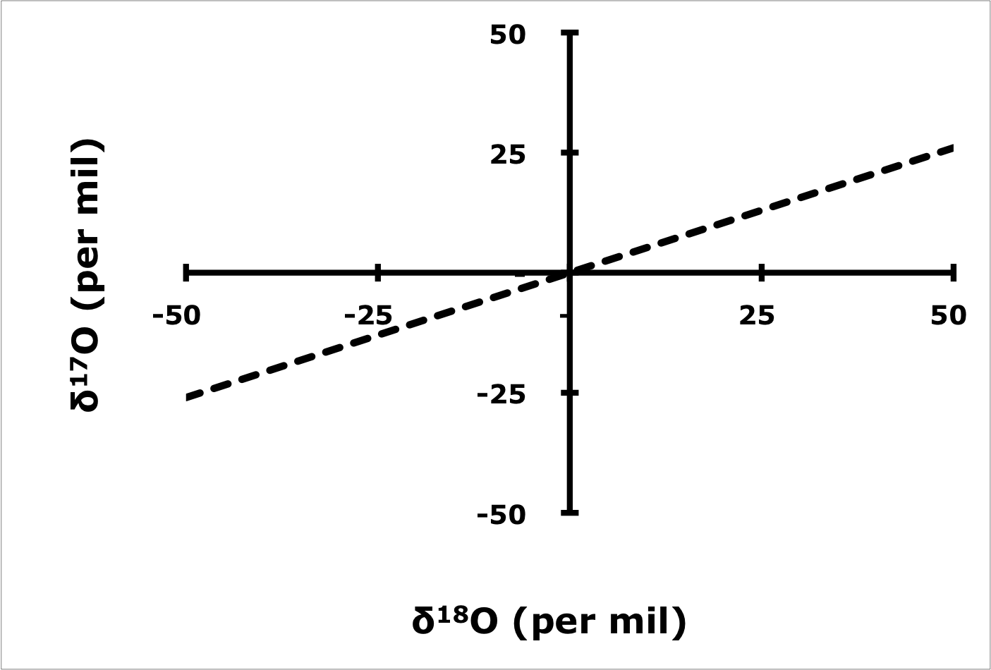
δ¹⁸O and δ¹⁷O
Δ¹⁷O = δ¹⁷O - 0.52*δ¹⁸O = 0
slope = 0.52
For most oxygen-bearing compounds:
δ¹⁷O = 0.52*δ¹⁸O
Terrestrial Fractionation Line

Slide 31
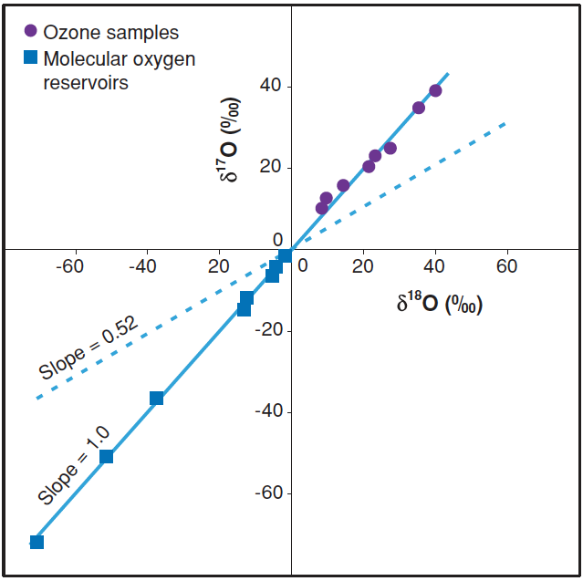
The Oxygen Isotope “Anomaly” (Δ¹⁷O) of Ozone
For Ozone (O₃):
δ¹⁷O ≠ 0.52*δ¹⁸O
Δ¹⁷O = δ¹⁷O - 0.52*δ¹⁸O = 20-35 ‰
Thiemens, 2006, Annu. Rev. Earth Planet Sci.

Slide 32
Isotope Transfer During NO_{X} Oxidation
Important nighttime NO₂ removal mechanism
NO₂ + O₃ NO₃ + O₂
N¹⁶O¹⁸O + ¹⁶O¹⁸O¹⁷O N¹⁶O¹⁸O¹⁷O + ¹⁶O¹⁸O
For Atmospherically-Derived Nitrate (NO₃⁻):
Δ¹⁷O = δ¹⁷O - 0.52*δ¹⁸O =
20-30 ‰ (tropospheric O₃), 30-40 ‰ (statospheric O₃)

Slide 33
δ¹⁵N (NO₃⁻) - Diurnal Variations

